Slide 1
3:30pm – 4:30pm
Most conference presentations will share “best practices”. That’s not this presentation. In this session we'll discuss what NOT to do. These surefire fail activities are inspired from real customer engagements (names changed to protect the innocent). Looking at the unsuccessful architecture and development patterns of others can help us not repeat the same mistakes in future cloud projects

Slide 2
10 Ways to Guarantee Your Microsoft Azure Project Will Fail!

Slide 3

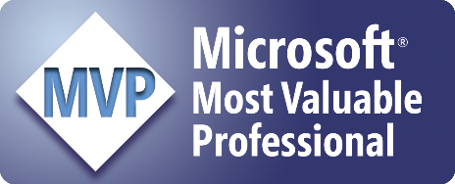
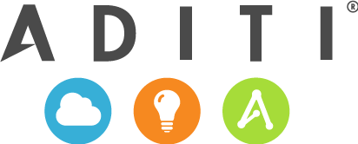
Michael S. Collier
Principal Cloud Architect
michaelc@aditi.com
@MichaelCollier
www.MichaelSCollier.com

Slide 4
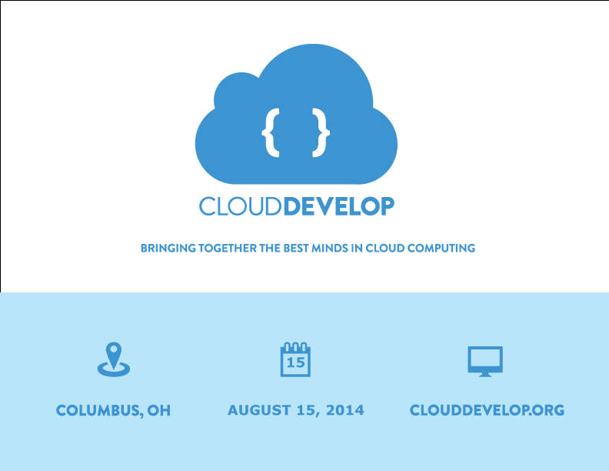
15

Slide 5
Central Ohio Cloud Computing User Group
What
Local user group for the sharing of ideas and learning about all things cloud computing. The group will not focus on any one vendor. Over the year there will be meetings to discuss Windows Azure, Amazon AWS, Google App Engine, and several others.
When
Second Monday of each month
6pm – 8pm
Where
Improving Enterprises
More Information
www.coccug.org
@coccug
April 14th
Jared Faris

Slide 6
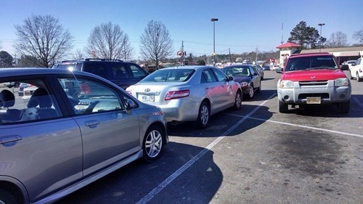
Disclaimer
This is a talk on what NOT to do.
Inspired by real projects . . . . Real people did this stuff!
Names withheld to protect the
“innocent”.
Do and you will #FAIL
and you’re paying me a lot of money to fix your $^!+ . . . . ☺
Justice is Served
Image courtesy of http://cheezburger.com/8106642432
Notes:
Sanitized and simplified in some scenarios to make it easier to describe in this setting.

Slide 7

More PowerPoint?!?
http://3.bp.blogspot.com/-3d9Cp2RCaH8/TalXvZKqqDI/AAAAAAAAFUc/0j4E-2rJ6qw/s1600/angry-baby-6.jpg

Slide 8
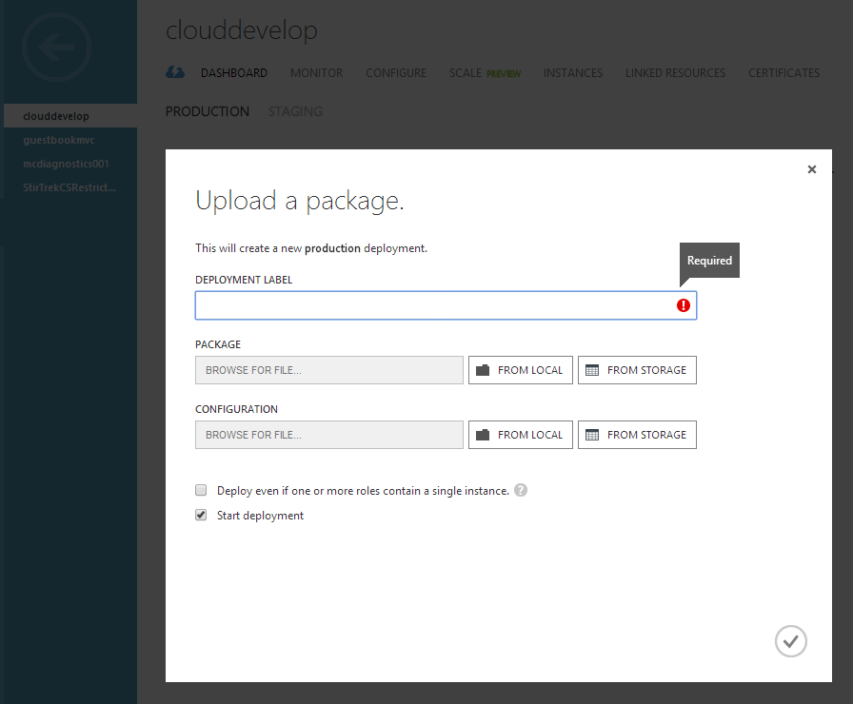
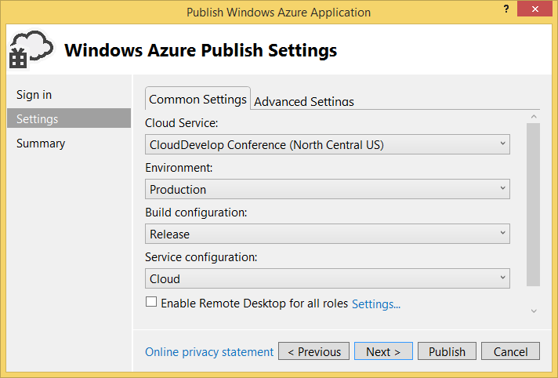
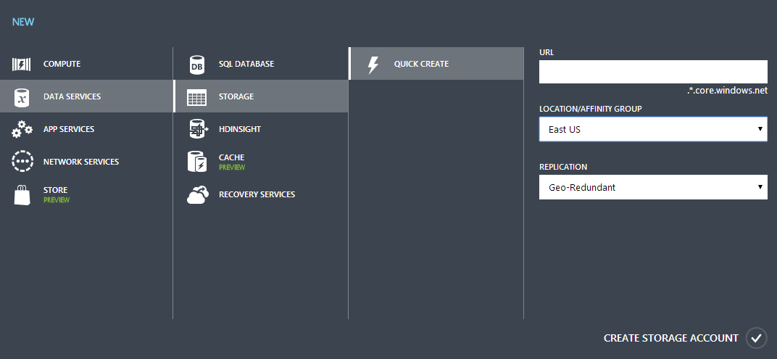
#10 – Lack of Automation
Manual deployments . . . #1 technique
Notes:
Start with an easy one . . . Too many projects fail to automate deployments and/or environment creation.
Take too long to deploy
Humans suck at repetitive tasks

Slide 9
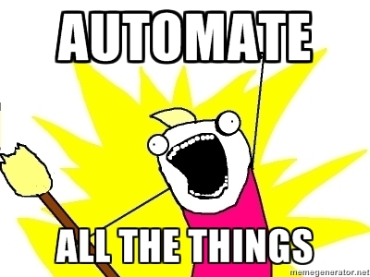
#10 – Lack of Automation
Use PowerShell to script the process
New-AzureService -ServiceName $MyServiceName -Location $MyServiceLocation
New-AzureStorageAccount -StorageAccountName $MyStorageAccountName `
-Location $MyStorageLocation -Verbose
New-AzureSqlDatabaseServer –AdministratorLogin $credential.UserName `
-AdministratorLoginPassword ` $credential.GetNetworkCredential().Password `
-Location $Location
New-AzureDeployment -ServiceName $MyServiceName -Slot Production `
-Configuration $MyConfigurationFilePath -Package $MyPackageFilePath
New-AzureQuickVM -Windows -ServiceName $svcName -Name $vmName `
-ImageName $image.ImageName -Location $location -AdminUsername $user -Password $pass
Notes:
Use PowerShell to script the process
Create all the resources – storage accounts, Cloud Service, VMs, Web Site, SQL Database, etc.
Deploy the package
Perform the VIP Swap
Invoke the script from build process

Slide 10

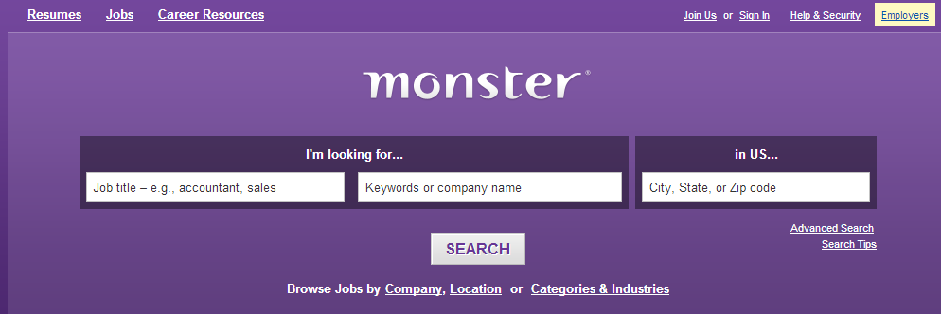
#9 – Poor Subscription Segregation
Single sub for Development, QA, and Production
Quotas
“Did I do that?”
Notes:
Saw this one more early on – not as much lately
Single sub for dev/qa/prod
As usage expands – more services, storage, SQL Databases, etc. – reach subscription quota limits
Azure doesn’t have role based access control - access is admin
Devs overwrite production data
http://www.careerplaybook.com/images/resumes/itprof/itprof1.gif
http://www.technologytell.com/entertainment/files/2012/10/urkel.jpg

Slide 11
#8 – Failure to Understand Core Features
Microsoft Azure provides anti-virus protection
FALSE
Endpoint Protection for Windows Azure is ooooold.
You want it, you install & manage it.
Notes:
Another one – which has several aspects – is a general failure to understand some core platform features
Microsoft Endpoint Protection for Windows Azure is ooooooooold. Works only with SDK 1.7.
You want anti-virus software, you need to install and manage it.
Need to really ask yourself what you’re protecting yourself from.

Slide 12
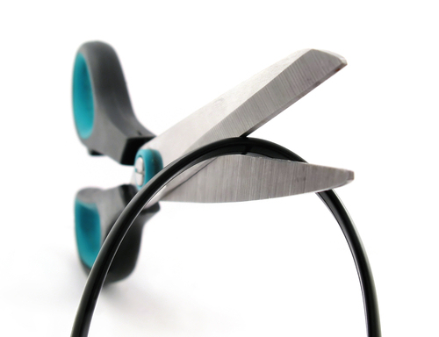
#8 – Failure to Understand Core Features
Microsoft Azure automatically protects against DDOS
FALSE
Azure will protect itself from attacks
What is “busy”?
Being successful looks a lot like a DDOS
Be Ready!
Notes:
Windows Azure will protect itself from attacks
What is “busy” for you may not be “busy” for others
Be Ready!
Implement an auto-scale policy
Involve a human
Log activity and be prepared to analyze
Open a ticket with Microsoft to investigate and shut down traffic
http://gigaompaidcontent.files.wordpress.com/2012/02/cord-cutting-cutting-the-cord-o.jpg?w=500

Slide 13
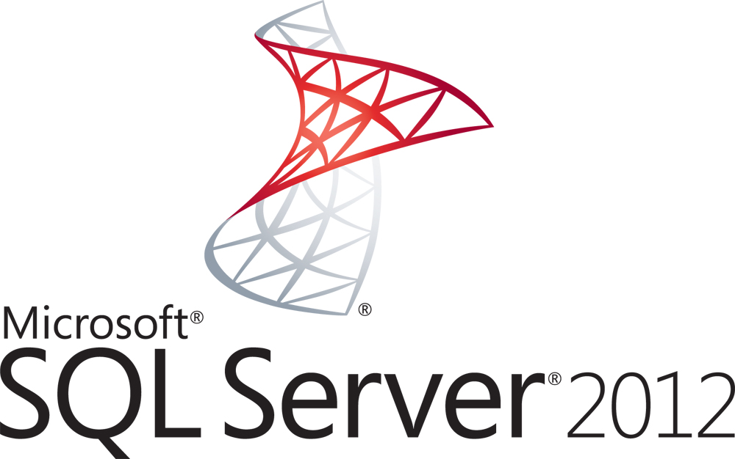
#8 – Failure to Understand Core Features
SQL Database supports encryption (TDE)
FALSE
!=
Understand the differences
SQL Server on an Azure VM?
Notes:
http://www.microsoft.com/en-us/news/imagedetail.aspx?id=D8D709456127F61BF4C13CF1E16D16922A089377
http://upload.wikimedia.org/wikipedia/zh/thumb/f/f5/SQLServerAzureLogo.png/250px-SQLServerAzureLogo.png

Slide 14
#7 – Everything has a Limit
Web Role
Storage Queue
Worker Role
SQL Database (Microsoft Azure)
100k’s devices
1KB every 2 seconds
Notes:
Another scenario I’ve seen lately is a belief that putting solution in the cloud will magically solve all physics problems.
Understand that EVERYTHING has a limit. Even the cloud!
Understand capacity/throughput limits on each service.
<CLICK>

Slide 15
#7 – Everything has a Limit
Web Role
Storage Queue
Worker Role
SQL Database (Microsoft Azure)
IIS limitations
20,000 tx per account*
2,000 msgs/sec
150 GB per DB
Transient Faults / Throttling
100k’s devices
1KB every 2 seconds
Notes:
IIS overhead – extra stuff to protect us.
Queue Limits
- If all the devices sent at the same time, would likely overload what a single queue could handle
Database
- Size would get to be a problem relatively quick . . . ~ 1MB/sec
- Database couldn’t handle that number of inserts that quickly

Slide 16
#7 – Everything has a Limit
Table Storage
Worker Role
OWIN/Katana
ASP.NET Web API
Worker Role
SQL Database (Microsoft Azure)
Batch messages
Retry
Storage Account
N
Notes:
Worker role now hosting Katana – light weight, fast. Takes the training wheels off. More dev responsibility.
Use multiple storage accounts, and multiple queues per account. Random distribution of messages.
Worker role to retrieve from queues in batches. Batch inserts into SQL. Handle retry failures. Optionally scale out database tier.

Slide 17
#6 – Infrastructure Planning
Managing infrastructure in cloud is like on-premises
X
10.0.0.4
10.0.0.12
10.0.0.20
10.0.0.28
10.0.0.36
Virtual Network
CIDR /27 = 32 hosts
Notes:
As more and more people use IaaS features, they stub their toe thinking infrastructure in cloud is same as on-prem
Error – not enough addressable space
.31 would be the lasts IP in a /27
Without a subnet, Azure was allocating VMs every 8 slots starting at .4 (0-3 reserved)

Slide 18
#6 – Infrastructure Planning
Managing infrastructure in cloud is like on-premises
10.0.0.4
10.0.0.5
10.0.0.6
10.0.0.7
10.0.0.8
AppSubnet
Virtual Network
Notes:
Solution – create a subnet.
IP addresses allocated sequentially starting at .4. Giving enough room to add the new VM.
Problem – can’t move VMs in a network once created, especially to a subnet.

Slide 19
#6 – Infrastructure Planning
Managing infrastructure in cloud is like on-premises
10.0.0.4
10.0.0.5
10.0.0.6
10.0.0.7
10.0.0.8
AppSubnet
Delete logical VM.
Create proper network.
Create VMs.
Virtual Network
Notes:
Solution – create a subnet.
IP addresses allocated sequentially starting at .4. Giving enough room to add the new VM.
Problem – can’t move VMs in a network once created, especially to a subnet.

Slide 20
#5 – Failure to Embrace Failure
Connecting to a Microsoft Azure SQL Database
public class OrderRepository
{
public OrderRepository()
{
}
public void Add(Order order)
{
using (var ctx = new OrderDbContext())
{
ctx.Orders.Add(order);
ctx.SaveChanges();
}
}
}
Notes:
One of the major points to remember in the cloud is that IT WILL FAIL. Sooner you embrace, better you’ll be.
Look at a simple, yet common scenario – connecting to a database.
http://msdn.microsoft.com/en-us/library/dn589784.aspx

Slide 21
#5 – Failure to Embrace Failure
public class OrderRepository
{
private readonly RetryPolicy policy =
new RetryPolicy<SqlDatabaseTransientErrorDetectionStrategy>(RetryStrategy.DefaultExponential);
public OrderRepository()
{
policy.Retrying += (sender, args) =>
{
// Write log statement
};
}
public void Add(Order order)
{
policy.ExecuteAction(() =>
{
using (var ctx = new OrderDbContext())
{
ctx.Orders.Add(order);
ctx.SaveChanges();
}
});
}
}
Retry Frameworks
Transient Fault Handling Application Block / “TOPAZ”
EF6
Windows Azure Storage Client Library
Notes:
Example using TOPAZ
Create your own detection strategy for your custom service.
10x
Up to 30 sec
http://msdn.microsoft.com/en-us/library/dn589784.aspx

Slide 22
#5 – Failure to Embrace Failure
Services will fail
Scenario
Single email provider
Unknown SLA
Retry strategy – retry until success (infinite)
What could possibly go wrong?
Didn’t have a max stop count
Didn’t have an alternative provider
Didn’t have a way to measure or enforce an SLA . . . . If the provider offered one.
Notes:
While the database can, and will, fail – so will external services you may take a dependency on.
storage outages. compute outages. cache outages.

Slide 23
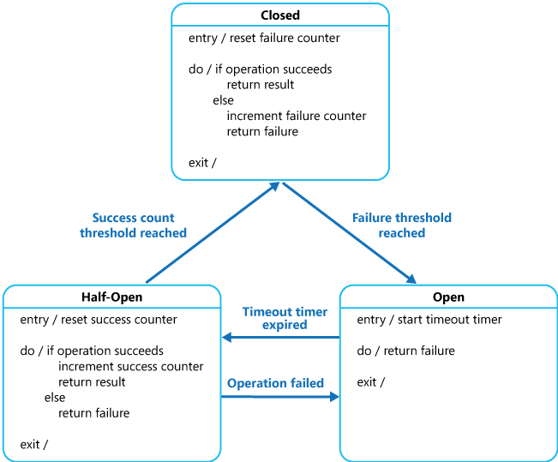
#5 – Failure to Embrace Failure
Constrain the Retry
Involve a human
Implement a circuit breaker pattern
More on Circuit Breaker pattern from Pattern’s & Practices - http://mcollier.net/1eCyTDu
Notes:
Consider ways to constrain the retry actions as part of the overall strategy
http://msdn.microsoft.com/en-us/library/dn589784.aspx

Slide 24
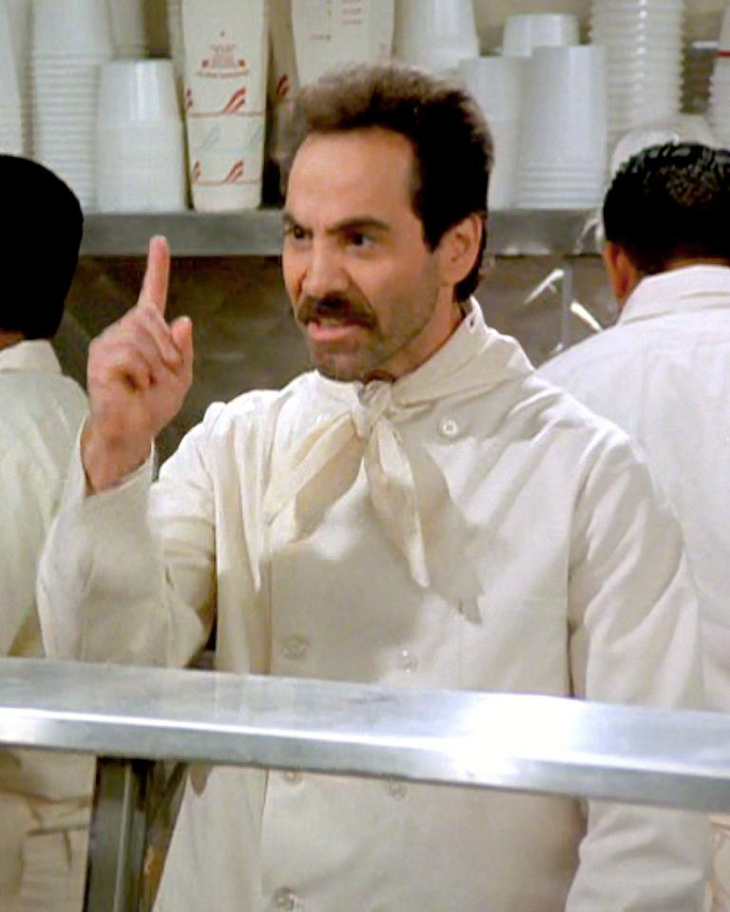
#5 – Failure to Embrace Failure
“Our site can’t go down. 100% uptime is the requirement.”
. . . This is hard, and expensive.
NO CLOUD
FOR YOU!
Cost vs. Impact
Notes:
Need to balance the impact of the failure against the cost to mitigate that risk. What is the damage that would be caused by a failure?
http://4.bp.blogspot.com/-ywsWLqZ0EYA/UrW47qFsMOI/AAAAAAAAFD8/4mdGWSUD-Mo/s1600/Soup-Nazi.jpg

Slide 25
#4 – Poor or No Scale Strategy
What is wrong here?
web role
web role
crazy.cloudapp.net
WASABi Auto-Scaler worker role
Notes:
Let’s take a look at this Cloud Service.
Not as wrong, as not very optimal
Scaler role included in the same cloud service – not easily reusable

Slide 26
#4 – Poor or No Scale Strategy
Include scaler in a separate cloud service
web role
web role
crazy.cloudapp.net
WASABi Auto-Scaler worker role
crazy-scale.cloudapp.net
Notes:
Break scaling role into separate cloud service – reuse later; not included in deployment updates to the target service.

Slide 27
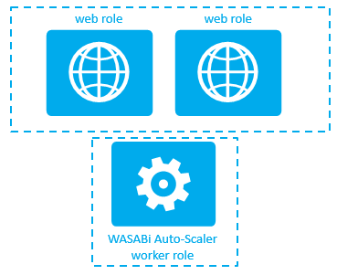
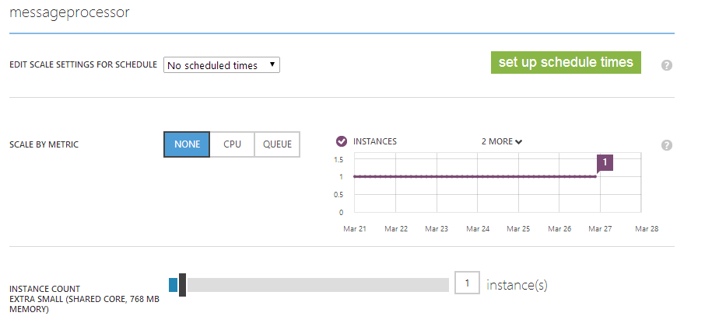

#4 – Poor or No Scale Strategy
Include scaler in a separate cloud service
Notes:
Invest in a custom scale solution or leverage pre-built solution
Azure portal
AzureWatch

Slide 28
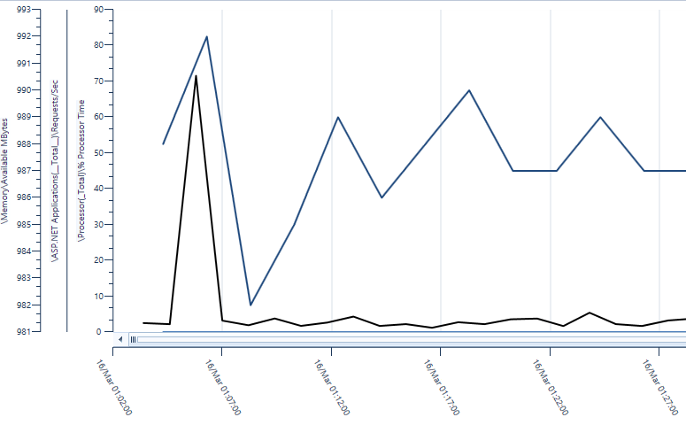
#4 – Poor or No Scale Strategy
“Azure will auto-scale when we’re busy”
FALSE
Logs
Instrumentation
Notes:
Talked about this a little earlier when talking about DDOS
What is busy?
Instrumentation is Key
Identify metrics that indicate “busy” – CPU %, queue depth, orders placed, etc.
Logs that you can analyze – friend or foe?

Slide 29
#4 – Poor or No Scale Strategy
“Azure will auto-scale when we’re busy”
FALSE
X
33% hit
X
25% hit
Notes:
While on topic of scale, let’s talk about capacity planning
Machine fails – Azure will spin up a new instance.
Spinning up new machines can take several minutes. Is that OK?

Slide 30
#3 – No Load or Performance Testing
Scenario
1 week before date of production launch. “Am I ready?”
Running of 4 instances of a Medium web role
Anticipated day one user load – 1 million users
load balancer
web role instances
Notes:
Kind of related to our previous points on auto-scaling and capacity.
“Have you performed any load tests?” … . “No”

Slide 31
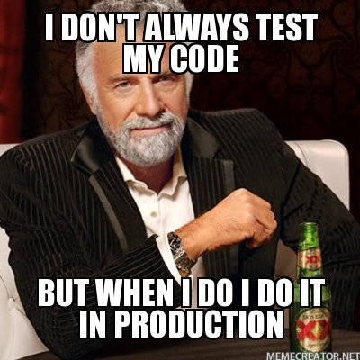
#3 – No Load or Performance Testing
Scenario
1 week before date of production launch. “Am I ready?”
Running of 4 instances of a Medium web role
Anticipated day one user load – 1 million users
load balancer
web role instances

Slide 32
#3 – No Load or Performance Testing
The Test
Reach 40 concurrent users before receiving errors and timeouts
10 users PER SERVER!
The Cause
No caching
No retry
Unnecessary hits to storage layer
Inefficient code
No tests
These are not “Azure” problems!
Notes:
The Test
Basic load test using LoadImpact.com
Reach 40 concurrent users before receiving errors and timeouts
10 users PER SERVER!
The Cause
No caching
No retry
Unnecessary hits to storage layer
Bad code
No tests
These are not “Windows Azure” problems!

Slide 33
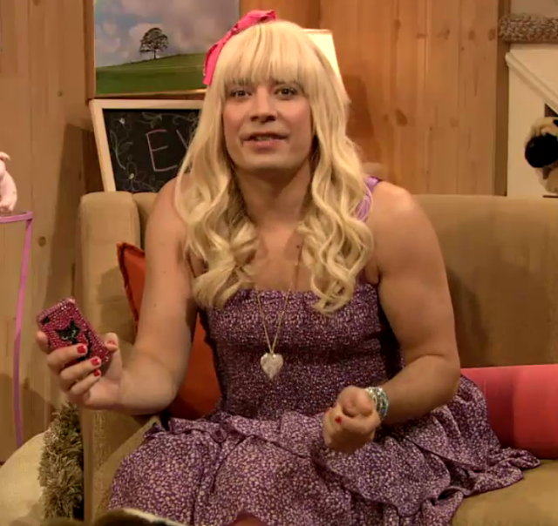
#2 – Throwing it Over the Wall
Scenario
Siloed development – Ops team not involved
Ops/Security tasked with ensuring app is supportable
Didn’t follow company standards for security, DR, support process, etc.
Security Guys . . .
Cloud? EW EW
Jimmy Fallon
Notes:
Seen this at a multiple projects in the last year.
Ops/Security Teams . . . Wrong people to piss off

Slide 34
#1 – Non-existent Instrumentation or Telemetry
Scenario
1 week before date of production launch. “Am I ready?”
Let’s run some tests and look at your logs
Logs? Yeah . . .we really don’t have logs.
OH . . .
Well, we eventually log any fatal errors, but that’s all.
I guess that’s better than nothing.
We looked at Azure diagnostic logging but didn’t see much value in it
Notes:
The #1 problem I see over & over

Slide 35

#1 – Non-existent Instrumentation or Telemetry
You’re kidding? Right?

Slide 36
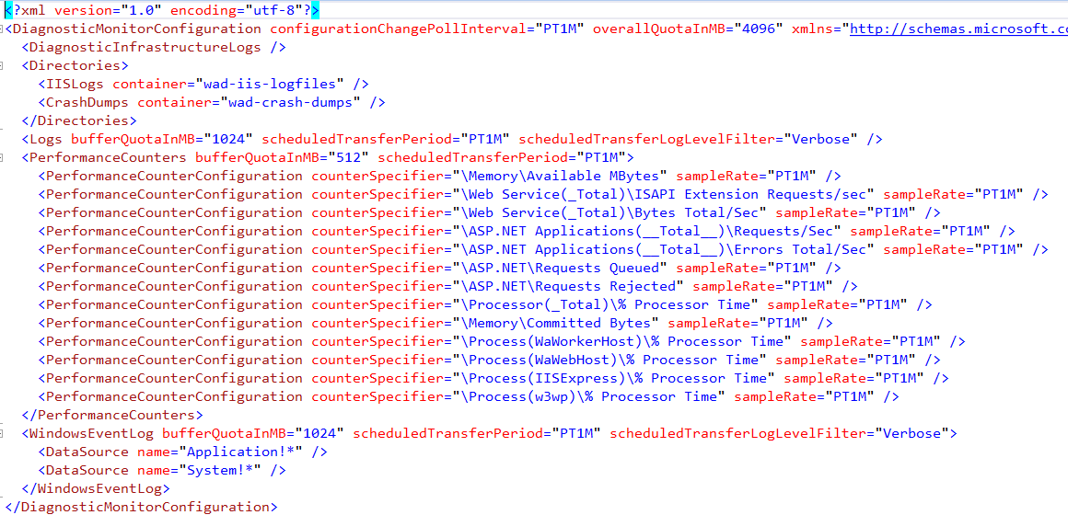
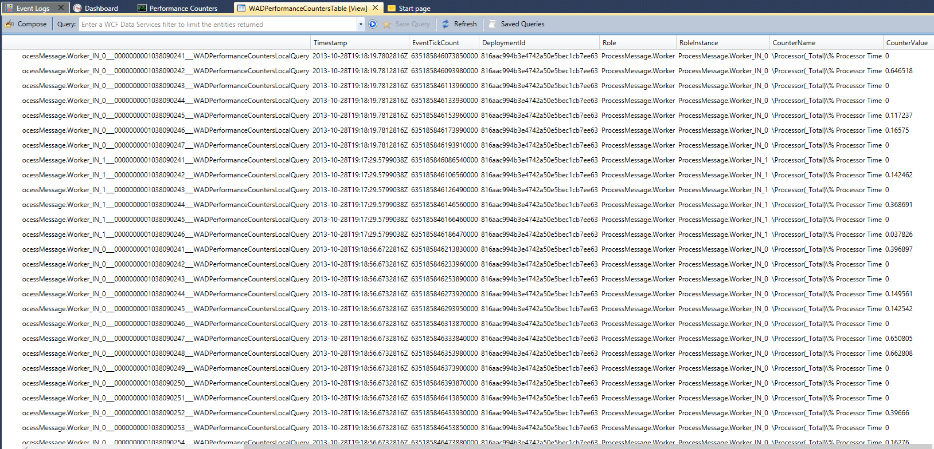
#1 – Non-existent Instrumentation or Telemetry
Instrumentation
Generation of custom monitoring and debugging information
Notes:
http://blogs.msdn.com/b/windowsazure/archive/2012/03/09/summary-of-windows-azure-service-disruption-on-feb-29th-2012.aspx

Slide 37
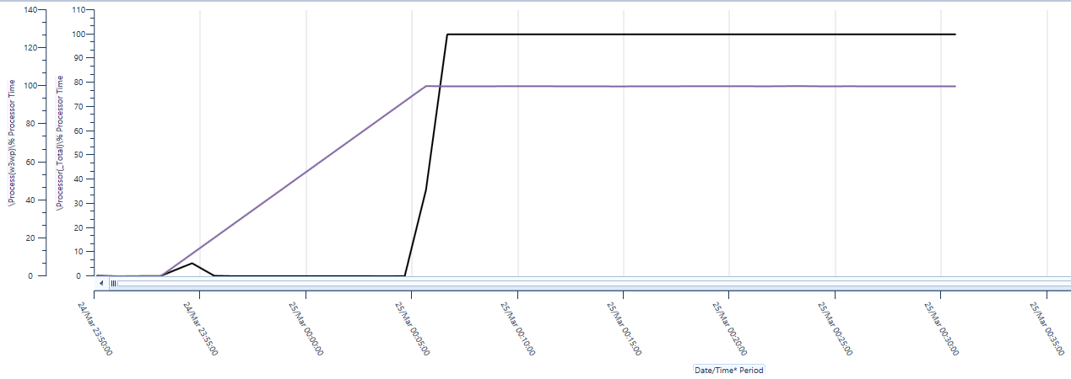
#1 – Non-existent Instrumentation or Telemetry
Instrumentation
Generation of custom monitoring and debugging information
Telemetry
Process of gathering the information collected by instrumentation.
Notes:
http://blogs.msdn.com/b/windowsazure/archive/2012/03/09/summary-of-windows-azure-service-disruption-on-feb-29th-2012.aspx

Slide 38
#1 – Non-existent Instrumentation or Telemetry
We Don’t Know What We Don’t Know
Preemptive vs. Reactionary
Recovery &
Root Cause Analysis
Notes:
We Don’t Know What We Don’t Know
Incredibly hard to find problems solely by looking at code
Preemptive vs. Reactionary
Regular analysis of telemetry data can help find problems before they become severe.
Recovery & Root Cause Analysis
What is failing?
Are we making it better or worse?
What caused this problem in the first place?
http://blogs.msdn.com/b/windowsazure/archive/2012/03/09/summary-of-windows-azure-service-disruption-on-feb-29th-2012.aspx

Slide 39
What Have We Learned?
3 Truths of Cloud Computing
Hardware
Fails
Software
Has
Bugs
People
Make
Mistakes
Microsoft blog post on RCA of leap day bug in 2012
Notes:
Work with cloud long enough, come to see 3 certain truths .. .
Look at most cloud failures . . .it’s people making a mistake, likely in configuration.
http://blogs.msdn.com/b/windowsazure/archive/2012/03/09/summary-of-windows-azure-service-disruption-on-feb-29th-2012.aspx

Slide 40
What Have We Learned?
Automation
Subscription Management
Understand the Platform
Understand the Limits
Plan the Infrastructure
Embrace Failure
Scale Strategy
Load & Performance Testing
Work Together
Instrumentation & Telemetry
Notes:
Let’s not repeat the mistakes of others
When building Azure projects, be sure to . . . .

Slide 41
Thank You!
Michael S. Collier
Principal Cloud Architect
michaelc@aditi.com
@MichaelCollier
www.MichaelSCollier.com

